Slide 1
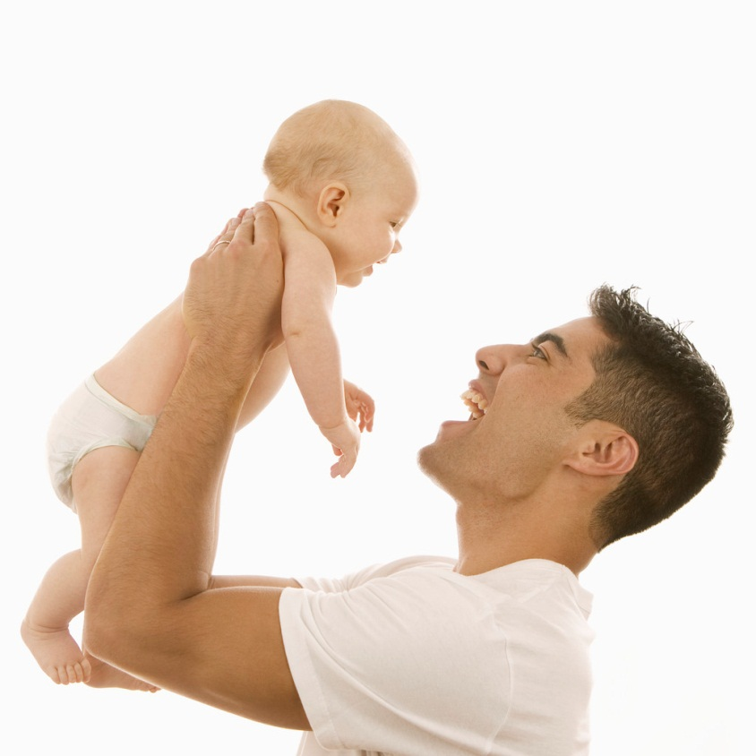
Emotional Development

Slide 2
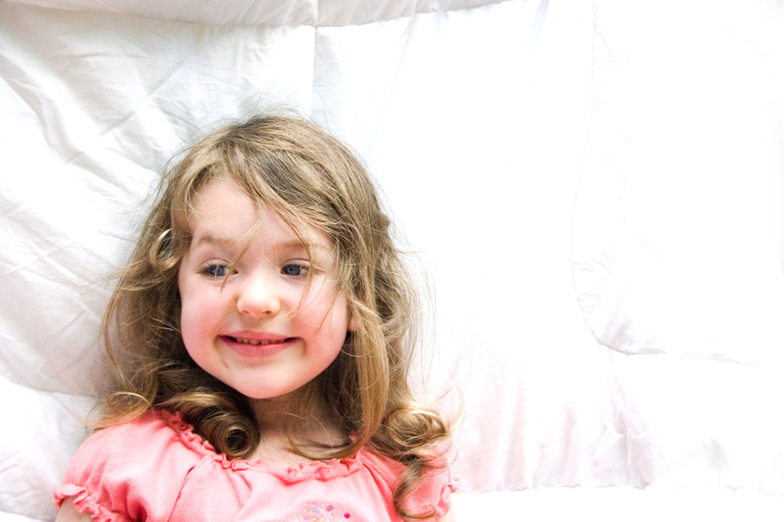
Emotional Development
DEFINITION
Learning to recognize feelings and express them appropriately

Slide 3
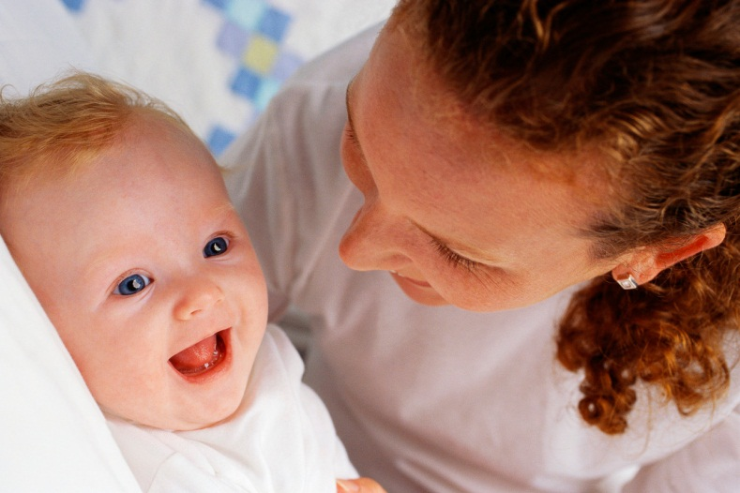
Emotional Development
INFLUENCED BY:
Heredity (Nature)
Determines temperament
Environment (Nurture)
Surroundings
Life events

Slide 4
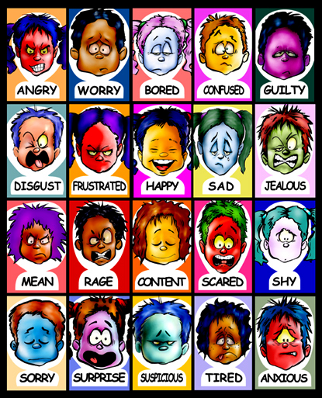
Emotional Development
Feelings
Emotions

Slide 5
Emotional Development
Pattern of emotional development as children grow in their ability to express and handle emotions

Slide 6
Emotional Development
INFANTS
Temperament
Style of reacting to the world and relating to others

Slide 7
Emotional Development
INFANTS
Nine views on temperament:
Each child has greater or lesser amount and need to be looked at in terms of all traits together to determine temperament
Intensity
Persistence
Sensitivity
Perceptiveness
Adaptability
Regularity
Energy
First Reaction
Mood

Slide 8
Emotional Development
INFANTS
Gradually develop emotions
At Birth: Pleasure to Satisfaction (Quiet) and Pain or Discomfort (Crying)
1-2mths: Delight (Smiling)
5 mths: Disgust- dislikes
8 mths: Elation- high spirits, Anger- don’t get their own way, and Fear- strangers
10 mths: Affection

Slide 9
Emotional Development
Emotional Timeline-
DEVELOPMENTAL MILESTONES
Working with your partner, create an emotional timeline. Refer to pages 308, 308 for newborn through 1 year and pages 378-391 for ages 1-3 and pages 458-477 for 4–6 year olds.
Read through each section, next find or draw pictures that illustrates each emotion and place it on the timeline.

Slide 10
Emotional Development
Toddlers
Capable of a full range of emotions, including complex feelings
Pride, jealousy
Egocentric
Self-centered, not capable of thinking beyond themselves

Slide 11
Emotional Development
Preschoolers
Begin to learn sharing and taking turns, they still see things only from their own point of view
Extreme emotions and short-lived
May rage instantly from minor frustrations, then calm to contentment very quickly
Fears become more intense

Slide 12
Emotional Development
Other important factors that affect emotions:
Independence
Self Image
Self Esteem

Slide 13
Emotional Development
Striving for independence
Waver between dependence and independence
New motor and intellectual skills spur toddlers and preschoolers to do more for themselves
Increases independence, boosts self-confidence

Slide 14
Emotional Development
Encourage independence
Teach children skills they need
Practice skills
Let children select what they wear
Chores
Praise efforts
Ask questions to encourage them to solve problems

Slide 15
Emotional Development
Self-Image: the way you view yourself
Gender Identity
Self-Esteem: positive feelings about oneself
Build Positive Self-Image & Self-Esteem

Slide 16
Self-Esteem
Children With High Self-Esteem:
Act independently
Assume responsibility
Take pride in their abilities
Deal with their emotions
Willingly accept new challenges
Handle problems efficiently
Children With Low Self-Esteem:
Feel unloved and unwanted
Blame others for their own mistakes
Avoid taking on new challenges or tasks
Put themselves down
Discredit their own abilities
Are easily influenced or manipulated by others

Slide 17
Emotional Development
Create “All About Me” using newspaper layout
Headline (your name and creative slogan)
Feature Story: Greatest Accomplishment
Self-Portrait (picture you brought in)
Favorites: Foods, Songs or Groups, Movie, Sport, School Subject, Color, Store
Describe Your Friends & Family
Personal Section Listing Your Strengths
Funniest Thing That Happened to You
Your Future Plans

Slide 18
Building a Positive Self-Image
Be accepting
Correct misbehavior
Criticize the behavior, not the child
Offer praise appropriately
Offer help tactfully
Commend effort, not achievement
Allow healthy risks and mistakes
Avoid comparisons
Encourage participation
Model appropriate self-esteem
Give children time, attention, and respect

Slide 19
Emotional Development
Encourage Affection
Infants brains thrive on affection from parents or caregivers- without it, areas of the brain where feelings of emotional closeness originate may not develop
Encourage Empathy:
The awareness of other people’s needs and feelings
Remind children that others have feelings

Slide 20
Difficult Emotions
At times, children may express emotions that need to be dealt with and handled accordingly.
Do not pass judgment on feelings, offer reassurance and guide children to express emotions in acceptable ways

Slide 21
Difficult Emotions
Jealousy
Praise accomplishments to let them know they are loved just as they are
Avoid comparisons
Human worth is not measured by a single quality

Slide 22
Difficult Emotions
Fear
Comfort instead of lecturing
Never force children into situations that frighten them
Never ridicule children’s fears
Never lie to children about their fears
Don’t ignore children’s fears

Slide 23
Difficult Emotions
Separation Anxiety
Realization that parents have to be away from them
Avoid leaving when the child is asleep or distracted
Discuss the separation matter-of-factly
Spend time together before leaving
Involve the child in an interesting activity
Be consistent
Leave quickly, with a smile and a wave goodbye

Slide 24
Difficult Emotions
Anger
Teach how to manage this basic emotion
Speak softly, remain calm and objective
Be sure children do not harm themselves, others, or possessions
At home, ignore the tantrum is there is no danger of injury
In public, take child to a quieter place
Save explanations for a calmer time
Don’t reward a child for ending a tantrum

Slide 25
Difficult Emotions
Negativism (Opposition)
Redirect the child
Don’t scold or punish for saying no
Don’t take it personally
Don’t offer a choice where none exists
Model a positive response

Slide 26
Difficult Emotions
Stress
Sources:
Death of a loved one
Divorce, separation, or remarriage of a parent
Moving to a new community
Family violence

Slide 27
Difficult Emotions
Stress
Evaluate expectations
Reassure children by talking, listening, hugging, and spending time with them
Calming effect
Cutting down on outside activities and hectic schedules
Make sure children get plenty of sleep and proper nutrition

Slide 28
Emotional Problems
At times, children have difficulty with emotional development which can lead to more serious emotional problems.
Adults should seek professional help for children in these circumstances.
* It is estimated that between 5-15% of children face emotional problems

Slide 29
Emotional Problems
Anxiety
Strong feelings of worry and fear
Talking to children to help them feel better
Anxiety Disorder:
Anxiety becomes so extreme it interferes with everyday life
Excessive worries about school, families, and health
Sweating, racing heart, and dizziness

Slide 30
Emotional Problems
Eating Disorders
Anorexia nervosa: self-starvation
Bulimia nervosa: vomiting or taking laxatives
What can parents do?
Accept their bodies and those of their children

Slide 31
Emotional Problems
Depression
Childhood depression is more than just “feeling down”
Affects about 5% of children
Overwhelming feeling of sadness that interferes with abilities to handle emotions and enjoy life
Signs of depression:
Frequent crying, lack of energy, lack of concentration, difficulty getting along with others, increasing anger, running away from home, marked personality change

Slide 32
Emotional Problems
Suicide
Children think life is too painful to continue living
Be aware of depression signs
Keep communication open
Don’t dismiss feelings that seem minor to you
Discuss suicide in a straightforward way
Recognize comments
Seek help if you have suspicion

